Slide 1

PROJECT EXHIBITION 1 (DSN2098)
STOCK MARKET DATA AND ANALYSIS IN PYHTON.
FACULTY- Dr. K MURUGESHWARI
GUIDE- Dr. VENKAT PRASAD PADHY

Slide 2



VIVEK KUMAR SAHU
20MIP10042
SREEPRADA CHINTAGINJALA
20MIP10049
OUR TEAM
MANOJ SEN
20MIP10022
TELUGUNTI AKHIL
20MIP10045
JAHNAVI GADIPUDI
20MIP10040

Slide 3
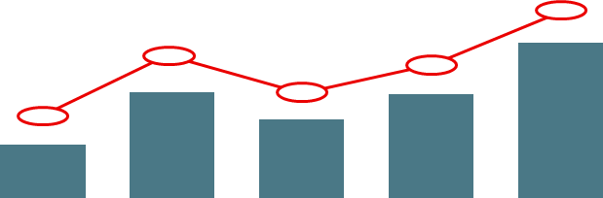
INTRODUCTION
INDIA’S EXPANDING ECONOMY AND ROBUST MIDDLE CLASS PROVIDE A LUCRATIVE MARKET FOR THE COMPANIES FROM ALL OVER THE WORLD. WE CAN ALSO SEE THAT INDIAN STOCK MARKET IS GOING IN BULLISH FORM FROM LAST 7-8 YEARS.
EVEN THE TOP 50 COMPANIES NIFTY50 OF INDIA HAS GIVEN MORE THAN 17% AVERAGE 5YEAR RETURN .IT HAS WITNESSED GROWTH LIKE NEVER BEFORE ATTRACTING INVESTORS FROM ACROSS THE WORLD TO INVEST IN INDIAN STOCKS.
AS A FAST DEVELOPING ECONOMY, THE MARKET IS SIGNIFICANTLY PULLING THE CROWD. WHEN WE SPEAK OF STOCKS IN INDIA, IT CAN MEAN THOSE REPRESENTING SMALL AND BIG COMPANIES LISTED IN THE NATIONAL STOCK EXCHANGE, BOMBAY STOCK EXCHAMGE AND OTHER BOURSES OF THE COUNTRY.
INVESTORS CANNOT DO AWAY WITH THE VOLATILITY OF THE SHARES MARKET. TRADING OF INDIAN STOCKS HAPPENS AT THE SAME MOMENTUM NO MATTER WHAT THE TIDE OF THE MARKET IS.
IT IS SWIMMING AGAINST THE TIDE SAFELY THAT MATTERS. SAFE SWIMMING IS CHOOSING POTENTIAL STOCKS IN INDIA. AND CHOOSING THE LUCRATIVE STOCKS AGAIN DEPENDS ON THE KNOWLEDGE YOU HAVE ABOUT THE MARKET OF STOCK IN INDIA AND HOW UPDATED YOU ARE.

Slide 4

AS NOW PEOPLES HAVE STARTED TAKING PART IN STOCK MARKET REALTED ACTIVITIES LIKE INVESTING DAY TRADING etc.
IN SUCH A SITUATION IT SEEMS THAT WE SHOULD INVEST MORE IN STOCKS, YET IF YOU LOOK AT THE NEWS YOU WOULD SEE THAT MOST MARKET ANALYSTS ARE CALLING THE CURRENT MARKET VERY EXPENSIVE TO INVEST IN.
SO DO WE TAKE THEIR WORD OR WE DO SOME DATA ANALYSIS TO FIND OUT OURSELVES?
HOW DO WE FIND GOOD COMPANIES IN A HIGHLY OVERVALUED MARKET?
IS THIS ANOTHER HYPE LIKE THE BITCOIN/CRYPTO-CURRENCY BUBBLE?

Slide 5


OBJECTIVE OF STOCK MARKET DATA AND ANALYSIS IN PYTHON
Get historical data for stocks.
Plot the stock market data and analyze the performance.
Get the fundamental, futures and options data.
There are so many factors involved in the prediction of stock market performance hence it becomes one of the most difficult things to do especially when high accuracy is required.
They are designed for forecasting, or predicting future prices. This is a tiresome exercise and hence needs plenty of learning to get into the actual process. The capabilities are publically available, even creating the tool itself.

Slide 6



LITERATURE REVIEW
• How to analyse stock data with Python - Satoshi goto
• Stock Technical analysis with Python-Created by diego Fernandez
• How to implement Financial Trading Strategies- Bob Mather
• Trading evolved(Anyone can build killer Trading Strategies in Python)-Andreas F. Clenow
• Stock Market Analysis in Python- Faizan Ahmed
• Stock Prediction in Python- Will Koehrsen
BUY

Slide 7
REAL TIME USAGE
Real-time data allows you to move with the market instead of playing catch up.
If you want to remain ahead of the curve and stay competitive in your market, you need to work with data delivered in real-time.
Volume data is counted on by technical traders. It indicates how seriously they should scrutinize a stock's price upward movement.
Market values will fluctuate on a dime. These evolving values can impact your analysis of a stock, so it's imperative that you're taking advantage of the most updated information.
Using real-time data, you can see the potential gain or loss you might incur at that moment. The profit and loss will recalibrate with each notch in a stock's price.
FLUCTUATING MARKET
TRADE VOLUME
GAIN AND LOSS
REAL TIME DATA
BEAT THE COMPETITION

Slide 8


SOFTWARES REQUIREMENT
SELL
PYTHON
JUPYTER NOTEBOOK
ANACONDA
MATPLOTLIB
BUY

Slide 9
System Architecture Diagram
Alpha Vantage is an online community for data analysis and predictive modeling.
It also contains dataset of different fields, which is contributed by data miners.
Various data scientist competes to create the best models for predicting and depicting the information. It allows the users to use their datasets so that they can build models and work with various data science engineers to solve various real-life data science challenges.
The dataset used in the proposed project has been downloaded from Kaggle.
However, this data set is present in what we call raw format. The data set is a collection of stock market information about a few companies. The first step is the conversion of this raw data into processed data.
This is done using feature extraction, since in the raw data collected there are multiple attributes but only a few of those attributes are useful for the purpose of prediction.
So the first step is feature extraction, where the key attributes are extracted from the whole list of attributes available in the raw dataset.

Slide 10
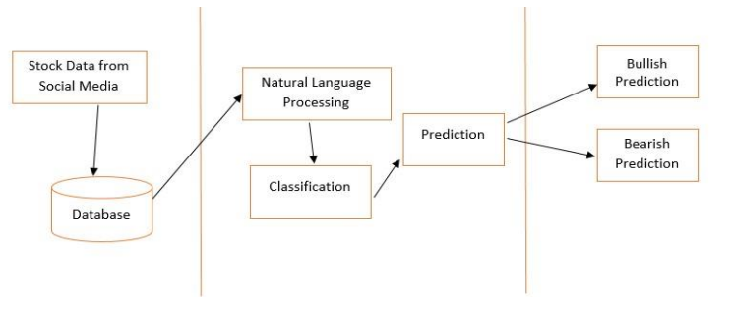
Feature extraction starts from an initial state of measured data and builds derived values or features. These features are intended to be informative and non-redundant, facilitating the subsequent learning and generalization steps. Feature extraction is a dimensionality reduction process, where the initial set of raw variables is diminished to progressively reasonable features for ease of management, while still precisely and totally depicting the first informational collection.
"Don't look for the needle in the haystack. Just buy the haystack!"
John Bogle
SIT AMET,

Slide 11
Modules Identification
TRAINING THE MACHINE
DATA COLLECTION
2
Training the Machine is similar to feeding the data to the algorithm to touch up the test data. The training sets are used to tune and fit the models. The test sets are untouched, as a model should not be judged based on unseen data. The training of the model includes cross-validation where we get a well-grounded approximate performance of the model using the training data. Tuning models are meant to specifically tune the hyper parameters like the number of trees in a Naïve Bayesian.
Data Collection is a very basic module and the initial step to towards the project . It generally deals with the collection of the right dataset. The dataset that is to be used in the market prediction has to be used to be filtered based on various aspects.
1
DATA SCORING
4
PRE-PROCESSING
The process of applying a predictive model to a set of data is referred to as scoring the data. The technique used to process the dataset is the Naive Bayesian Algorithm. Naïve Bayesian involves an ensemble methods, which is usually used, for classification and as well as regression. Based on the learning models, we achieve interesting results.
Data pre-processing is a part of data mining, which involves transforming raw data into a more coherent format. Raw data is usually, inconsistent or incomplete and usually contains many errors.
3

Slide 12
RESULT
ACCURACY
EFFICIENCY
THROUGHPUT
TIME DELAY
01
03
THROUGHPUT
ACCURACY
Accuracy is used to describe the closeness of a measurement to the true value. In our the project we get the true value related to the Classes defined for the High Price and Low Price related keywords.
It is the work done by a system in a given period. The system works out the process of fetching the comments from the Facebook pages in the given time.
02
EFFICIENCY
04
TIME DELAY
It is the performance of the system to accomplish something with the least waste of time and efforts. It is usually expressed in percentage. In our system the keyword mentioned in the comment for any stock is efficiently matched with the word dictionary.
It is a delay between two operations designed to make it safer or more efficient. The time delay may introduce while data is fetching and processing by the system.

Slide 13
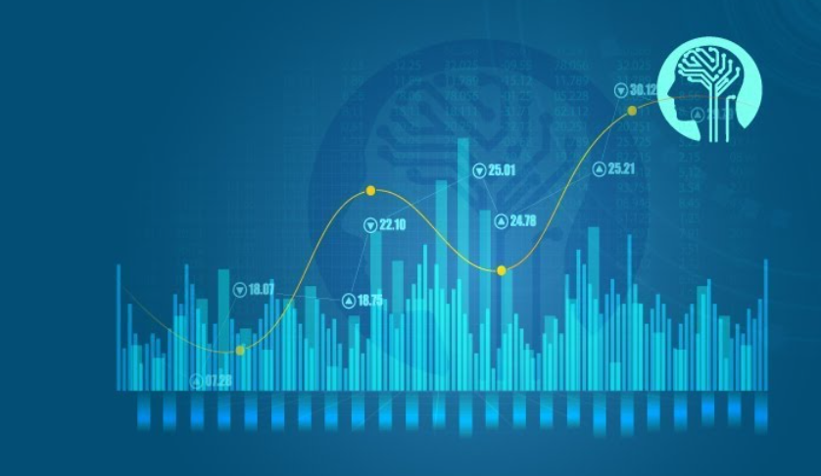

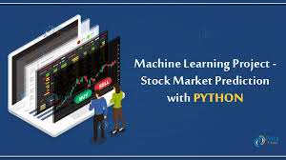

REFERENCES
The Python Bible Volume 5: Python For Finance (Stock Analysis, Trading, Share Prices)
STOCKER, MATPLOTLIB, Chrome Inspector (Dev Tools) etc.
https://towardsdatascience.com/stock-market-analysis-in-python-part-1-getting-data-by-web-scraping-cb0589aca178

Slide 14


PROJECT TIMELINE
MILESTONE -1
MILESTONE -2
MILESTONE -3
14/09/21
21/10/21
18/12/21
TASK -4
TASK -6
OCT 10 – OCT 20
DEC 1 – DEC 17
TASK -1
SEP 15
TASK -2
TASK -5
SEP 13 – SEP18
NOV 9 – NOV 30
TASK -3
TASK-1 FORMING GROUPS
TASK-2 PRESENTING(REVIEW-1)
TASK-3 WORKING ON EXPERIMENTS
TASK-4 PREPARING AND FINAL DISCUSSION FOR PPT(REVIEW-2)
TASK-5 WORKING ON FINALIZING OUR CODING PART
TASK-6 FINALIZING OUR PRESENTATION(REVIEW-3)
SEP 20 – OCT10

Slide 15

CONCLUSION
This paper condenses significant methods in ML which apply to stock expectation. The paper presents the utilization of direct relapse and strategic relapse for stock forecast and stock examination and this investigation prescribes Naive Bayesian to get precise outcomes. An imperative to this end is the need of the dataset utilized in the forecast to be grouping cordial. The paper outlines the apparatuses which can be utilized for the execution of ML calculations. Every one of the instruments bolsters relapses and grouping calculations, clients can pick any device dependent on their nature and accommodation. The paper proposes a framework to extricate learning from information and playing out an expectation to prompt the shopper for ventures as well as the sentiment analysis of the users from social media data.

Slide 16


